Slide 1

The Agile Approach
Aaron Albrecht

Slide 2
Agenda
Agile Roles
SDLC Phases in Agile
Waterfall Approach
Waterfall vs Agile

Slide 3
Scrum-Agile Team Roles
Scrum Master
Ensures effective backlog management
Coaches development team in self-organization and cross-functionality
Helps development team create high-value products
Leads and coaches organization in scrum adoption/plans scrum implementation,
helps employees and stakeholders understand and enact Scrum
Product Owner
Optimizes value of development team’s work
Orders items in product backlog to achieve goals
Clearly expresses product backlog items
Ensures product backlog is visible, transparent, and clear to all

Slide 4
Scrum-Agile Team Roles
Developer
Designs and develops code according best practices
Turns product backlog into functioning code
Self-organized with no individual titles or subgroups
Accountability is on the team as a whole, not an individual
Tester
Defines acceptance criteria
Clarifies ambiguity in user stories
Executes the code and tests the results
Collaborates with team to resolve any errors or bugs within the code

Slide 5
Agile Phases of the SDLC
Requirement Gathering
understand and prioritize needs for the project
Design
Requirements are translated into actionable tasks
Develop visual representations to get early feedback to ensure alignment with stakeholder expectations
Coding
Development team implements software in short, iterative cycles called sprints
Each sprint focuses on delivering small, functional increments of the product
Testing
Ensures quality and functionality of software
Deployment
Releasing the software increments to production frequently and reliably
Feedback
Crucial for continuous improvement
Stake holders and end-users provide feedback through surveys, direct communication, and analytics

Slide 6
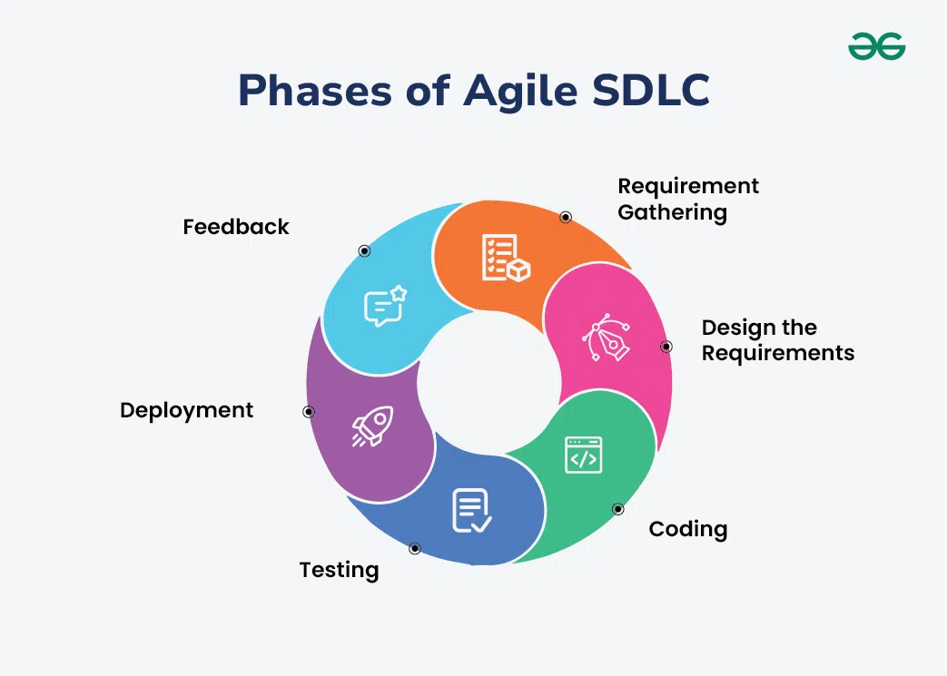
Agile Phases of the SDLC

Slide 7
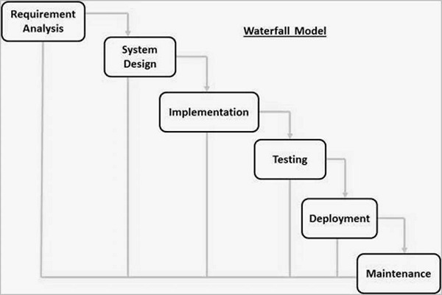
The Waterfall Method

Slide 8
The Waterfall Method
The waterfall method was the earliest SDLC approach that was used for software development
The whole process is divided into separate phases that “cascade” from one to the next
The next phase is only started after the defined set of goals are achieved for the previous phase and is signed off
The phases do not overlap
During the SNHU Travel project, the user stories had been initially set. Then after feedback some adjustments to those stories were needed. If the waterfall method had been used instead of agile, the whole process would be set back because the requirements and design would have changed stopping any progress until the previous steps are redone. One of the changes the client had requested was for wellness and detox options because that has become a hot topic and popular among the customers. Without having that direction already in place, the waterfall method required the team to go back and replan the requirements.

Slide 9
Waterfall vs Agile
Flexibility
Agile-able to adapt at each iteration
Waterfall-plan aims to remain fixed once approved, no room for changes without major setbacks
Timelines
Agile-projects move much more quickly due to higher flexibility and not having rigid steps
Waterfall-projects often take longer than agile, especially during planning
Client Involvement
Agile-continuous customer/stakeholder participation (surveys, demos)
Waterfall-heavy involvement early during planning but not as much during production

Slide 10
Conclusion
In summary, by using the agile method during the SNHU Travel project, we were able to turn out a high-quality, customer-oriented product. Although there will be a difficult transition, I would highly recommend transitioning all of ChadaTech to follow the agile method. In so doing we will be able to produce higher quality software and have more cohesive teams with communication and transparency.

Slide 11
References
Cobb, C. G. (2015). The Project Manager’s Guide to Mastering Agile: Principles and Practices for an Adaptive Approach (1st ed.) [E-book]. Wiley.
Geeks for Geeks. (2025, July 23). Agile SDLC (Software Development Life Cycle). https://www.geeksforgeeks.org/software-engineering/agile-sdlc-software-development-life-cycle/.
Tutorials Point. (2026). SDLC – Waterfall Model. https://www.tutorialspoint.com/sdlc/sdlc_waterfall_model.htm.
Webster, W., & Greenberg, T. (2026, March 26). Agile vs Waterfall Methodology: Differences & How to Choose. https://project-management.com/agile-vs-waterfall/.
11

